Slide 1
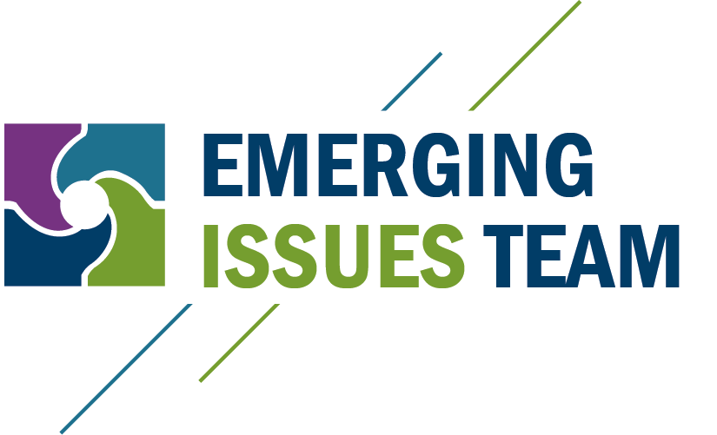

Slide 2
Regulatory and EMDF Update
Regulatory Partnership Framework
Update on Proposed EMDF Status
Questions

Slide 3
Regulatory Partnership Framework
REGULATORY PARTNERSHIP FRAMEWORK
Three Tiers of Teams | TEAM | TEAM MEMBERS (Including OREM, UCOR, EPA and TDEC)
 | Leadership Team | Senior Leadership
 | Emerging Issues Team | Program and Policy Managers
 | Project Teams | Project Managers and Specialists

Slide 4
EMDF Status
EMDF proposed to help continued, steady cleanup
Proposed Plan public review and comment
September 10, 2018 to January 9, 2019
Next step is draft Record of Decision (ROD) submittal this spring.
Responses to public comments will be in the draft ROD.
Regulatory Partnership Teams have made significant progress on EMDF aspects.

Slide 5
Waste Acceptance Criteria
OREM is developing draft Waste Acceptance Criteria that will be submitted to the regulators.
Broad agreement on mercury management
Elemental mercury and mercury hazardous waste shipped offsite
Mercury water discharges will meet AWQC
Evaluate other mercury reduction technologies
The parties anticipate additional public engagement on the Waste Acceptance Criteria.

Slide 6
Site Characterization
OREM will conduct a groundwater field study to establish the EMDF post-construction groundwater elevation.
Key elements of the groundwater field study will be included in the Record of Decision.
Results of the groundwater field study will be used to establish groundwater level for design.
Permanent underdrains will not be used to suppress groundwater.

Slide 7
Wastewater Discharge
On December 31, 2020, the EPA Administrator made a final decision related to radiological wastewater discharges.
The decision requires DOE to develop discharge limits based on site-specific exposure information.
The maximum exposure will potentially be to a recreational fisherman.
A fish study will be conducted in Bear Creek to gather data for use in the discharge limits.

Slide 8
Stakeholder Outreach
OREM is planning for community and stakeholder outreach related to EMDF in consultation with EPA and TDEC.
OREM desires to actively share information with the community and stakeholders on various aspects as described above.
The current COVID 19 pandemic will likely drive information sharing by innovative, non-contact methods, such as via the internet.

Slide 9
Questions?

